Slide 1
Allocation of a starting point for guided visits to Madrid’s monuments and museums

Slide 2
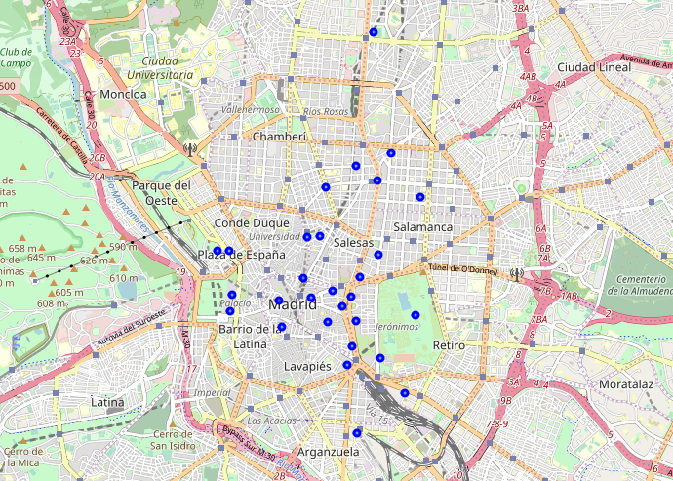
the problem
a CLIENT OF OURS WANTS TO FIND A SUITABLE PLACE TO PLACE THE MEETING POINT FOR TOURISTS WANTING TO EMBARK O A SPECIAL TOUR OF THE CITY MOST CENTRIC MONUMENTS / museums as well as define the tours themselves

Slide 3
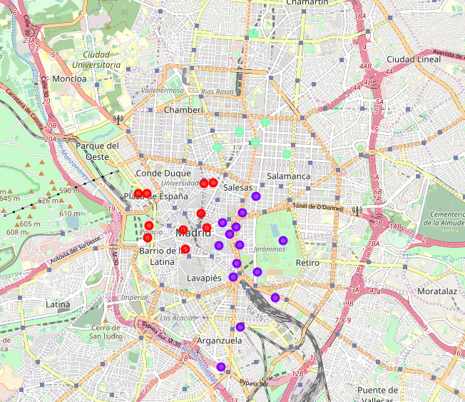
The tours
This photo shows the three resulting “tours” (clusters) defined using the k-means clustering technique

Slide 4
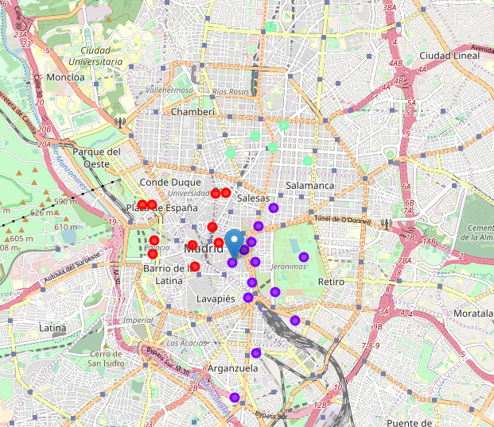
The SOLUTION
After leveraging the data, the starting point was calculated via centroid (it is denoted by the different tag marker)

